Slide 1
Machine Learning
Asieh Daneshi 2024

Slide 2
What is Machine Learning?
Machine Learning is a subdomain of computer science that focuses on algorithms which help a computer learn from data without explicit programming
What is the difference between AI and ML and DS?
Artificial intelligence is an area of computer science, where the goal is to enable computers and machines to perform human-like tasks and simulate human behavior
Machine learning is subset of AI that tries to solve a specific problem and make predictions using data
Data science is a field that attempts to find patterns and draw insights from data (might use ML!)

Slide 3
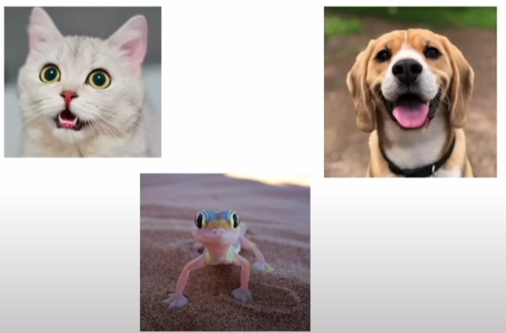
Types of Machine Learning
Supervised learning - uses labeled inputs (meaning the input has a corresponding output label) to train models and learn outputs
Cat Dog Frog

Slide 4
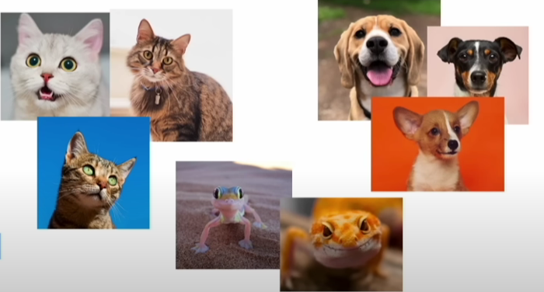
Types of Machine Learning
Supervised learning - uses labeled inputs (meaning the input has a corresponding output label) to train models and learn outputs
Unsupervised learning - uses unlabeled data to learn about patterns in data

Slide 5


Types of Machine Learning
Supervised learning - uses labeled inputs (meaning the input has a corresponding output label) to train models and learn outputs
Unsupervised learning - uses unlabeled data to learn about patterns in data
Reinforcement learning – agent learning in interactive environment based on reward and penalties

Slide 6
Machine Learning
Input 1
Input 2
Output (prediction)
Model
…
Input n
Notes:
This is the general structure of a machine-learning model.
Today, we focus on supervised learning. But before that, let’s make sure that we are on the same page and use the same names for the same concepts.

Slide 7

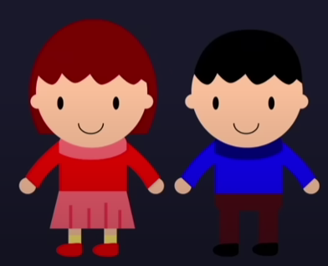
Features
Qualitative – categorical data (finite number of categories or groups)
Nominal Data (no inherent order)

Slide 8
One-Hot Encoding
Every time we just focus on a specific category and label data from that category 1, and all the others are 0
Country | One-Hot Encoding
Japan | 1,0,0,0
China | 0,1,0,0
Germany | 0,0,1,0
Canada | 0,0,0,1

Slide 9
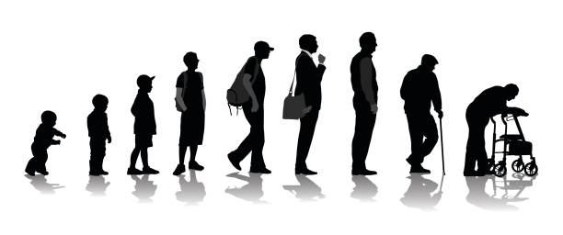
Features
Qualitative – categorical data (finite number of categories or groups)
Ordinal Data (inherent order)

Slide 10
We can assign a number to any of these categories
1 2 3 4 5 6 7 8 9

Slide 11
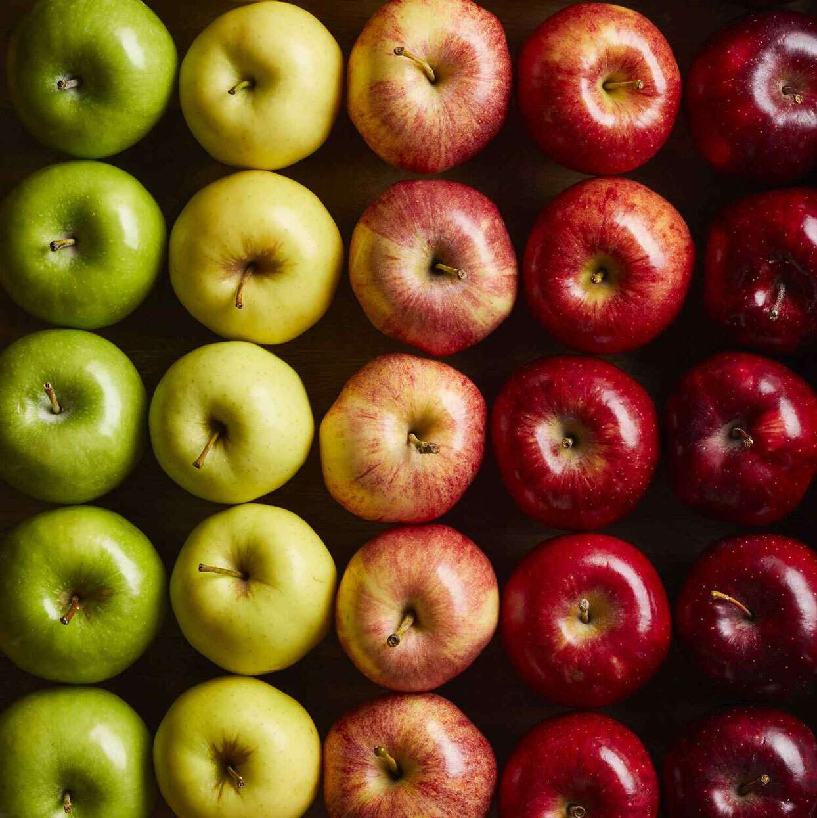
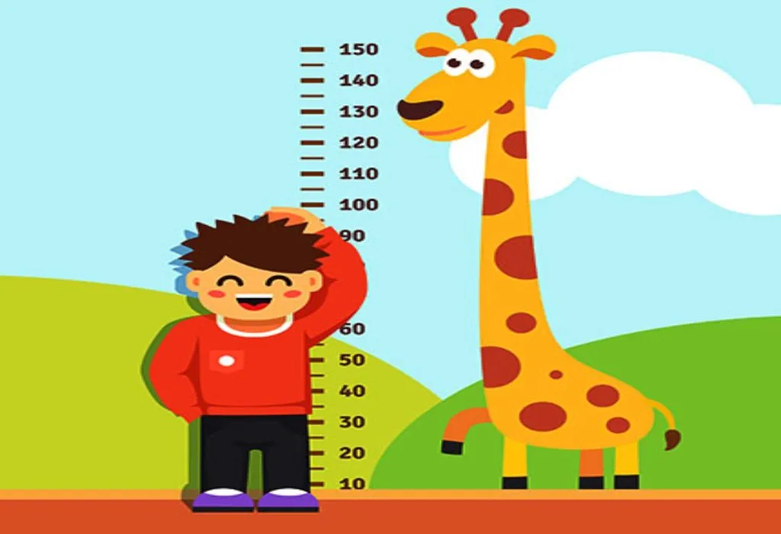
Features
Quantitative – numerical valued data (discrete or continuous)

Slide 12
Machine Learning
Input 1
Input 2
Output (prediction)
Model
…
Input n
Notes:
This is the general structure of a machine-learning model.
Today, we focus on supervised learning. But before that, let’s make sure that we are on the same page and use the same names for the same concepts.

Slide 13
Supervised Learning
Classification – predict discrete classes
Multiclass classification
Notes:
This is the general structure of a machine-learning model.
Today, we focus on supervised learning. But before that, let’s make sure that we are on the same page and use the same names for the same concepts.

Slide 14
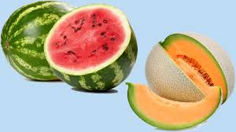
Classification – predict discrete classes
Binary classification
Notes:
This is the general structure of a machine-learning model.
Today, we focus on supervised learning. But before that, let’s make sure that we are on the same page and use the same names for the same concepts.

Slide 15
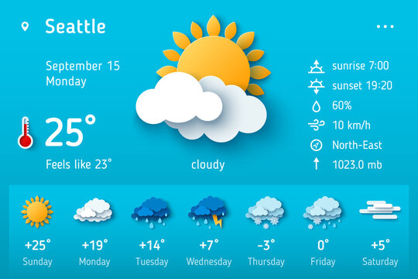
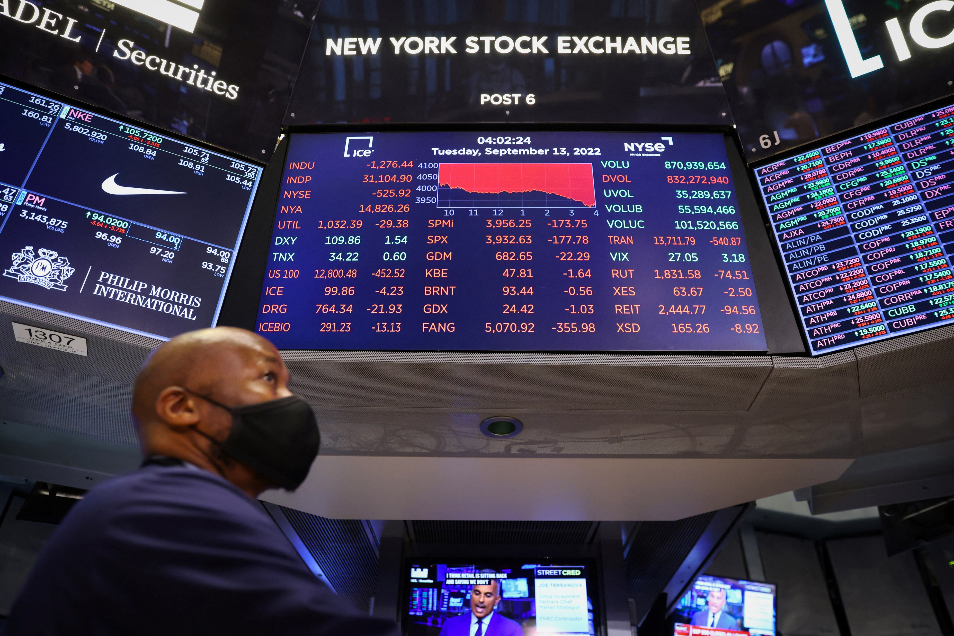
Supervised Learning
Regression – predict continuous values
Notes:
This is the general structure of a machine-learning model.
Today, we focus on supervised learning. But before that, let’s make sure that we are on the same page and use the same names for the same concepts.

Slide 16
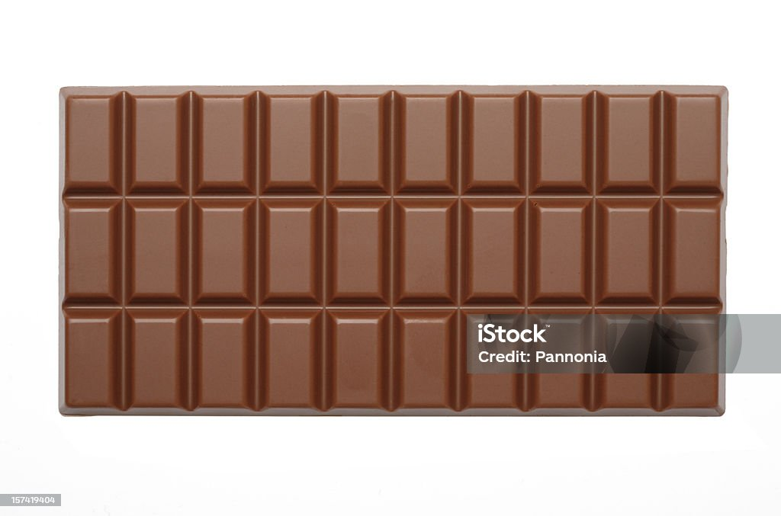
Training
Model
Don’t use all chocolates for training!
. . .
Notes:
We feed data row by row to our model, and receive output.

Slide 17
Training dataset
Validation dataset
Testing dataset

Slide 18
Training
Model
. . .
Loss
Notes:
During the training process, we adjust our model to decrease the loss function as much as possible!

Slide 19
Validation
Model
Loss
Notes:
To make sure that the model works with new data!

Slide 20
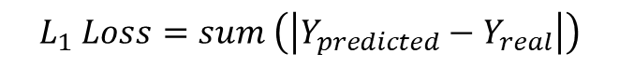

$$L_{1} Loss=sum \left(\left|Y_{predicted}−Y_{real}\right|\right)$$
$$L_{2} Loss=sum \left({\left(Y_{predicted}−Y_{real}\right)}^{2}\right)$$

Slide 21
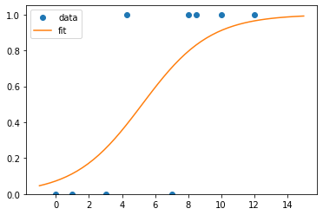

Binary Cross-Entropy $Loss=−\frac{1}{N}∗sum(y_{real}∗\log\left(y_{predicted}\right)+\left(1−y_{real}\right)∗log⁡(1−y_{predicted}))$
This loss function gives you the probability that each data point belongs to one of our two classes!

Slide 22
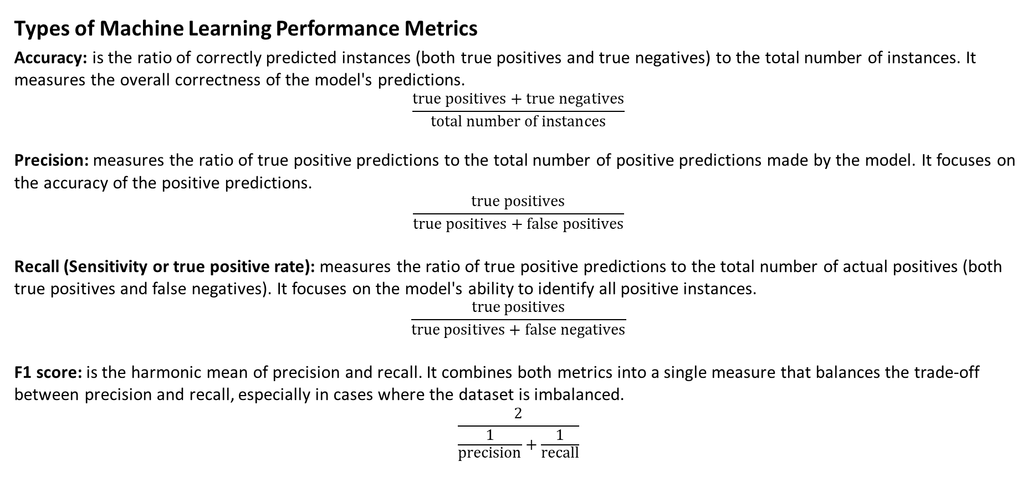
Types of Machine Learning Performance Metrics
Accuracy: is the ratio of correctly predicted instances (both true positives and true negatives) to the total number of instances. It measures the overall correctness of the model's predictions.
$$\frac{true positives+true negatives}{total number of instances}$$
Precision: measures the ratio of true positive predictions to the total number of positive predictions made by the model. It focuses on the accuracy of the positive predictions.
$$\frac{true positives}{true positives+false positives}$$
Recall (Sensitivity or true positive rate): measures the ratio of true positive predictions to the total number of actual positives (both true positives and false negatives). It focuses on the model's ability to identify all positive instances.
$$\frac{true positives}{true positives+false negatives}$$
F1 score: is the harmonic mean of precision and recall. It combines both metrics into a single measure that balances the trade-off between precision and recall, especially in cases where the dataset is imbalanced.
$$\frac{2}{\frac{1}{precision}+\frac{1}{recall}}$$
 | positive | negative
true | True positive | True negative
false | False positive | False negative
Notes:
Recall measures the ability of the classifier to find all the relevant cases within a data set. It’s the ability of the classifier to find all the positive samples. Recall is important when missing positive instances (false negatives) is more critical than having false positives. For example, in cancer detection, it's crucial to catch all actual cases even if it means some false alarms.
The F1 score is the harmonic mean of precision and recall, providing a balanced measure that considers both false positives and false negatives. It's especially useful when dealing with imbalanced data sets. Use the F1 score when you want to balance precision and recall and there is an uneven class distribution or when false positives and false negatives carry similar weights.

Slide 23
Hands-on coding
Let’s start with looking into our data:
df = pd.read_csv("Session1Data.data")
The data comes from a telescope. There are some high-energy particles that the telescope is observing their radiation. The dataset includes some features recorded from these particles and their radiations that help us to understand if the particles were gamma or hadron.
cols = ["fLength", "fWidth", "fSize", "fConc", "fConc1", "fAsym", "fM3Long", "fM3Trans", "fAlpha", "fDist", "class"]
df = pd.read_csv("Session1Data.data", names=cols)
Variable Name | Role | Type | Description | Units | Missing Values
fLength | Feature | Continuous | major axis of ellipse | mm | no
fWidth | Feature | Continuous | minor axis of ellipse | mm | no
fSize | Feature | Continuous | 10-log of sum of content of all pixels | #phot | no
fConc | Feature | Continuous | ratio of sum of two highest pixels over fSize |  | no
fConc1 | Feature | Continuous | ratio of highest pixel over fSize |  | no
fAsym | Feature | Continuous | distance from highest pixel to center, projected onto major axis |  | no
fM3Long | Feature | Continuous | 3rd root of third moment along major axis | mm | no
fM3Trans | Feature | Continuous | 3rd root of third moment along minor axis | mm | no
fAlpha | Feature | Continuous | angle of major axis with vector to origin | deg | no
fDist | Feature | Continuous | distance from origin to center of ellipse | mm | no

Slide 24
To see the first 5 rows of our data:
df.head()
To see how the different elements in a data column use:
.unique()
df["class"].unique()
To convert qualitative (categorical) to quantitative (nominal), if we have only two categories:
df["class"] = (df["class"] == "g").astype(int)
If we have more than two categories:
df["class"] = df['class'].astype('category').cat.codes
Or, do the mapping manually:
labels = df["class"]
label_mapping = {uniqueClasses[0]:0, uniqueClasses[1]:1}
numerical_labels = [label_mapping[label] for label in labels]
df["class"]=numerical_labels

Slide 25
First, convert the labels from letters to numbers.
df["class"] = (df["class"] == "g").astype(int)
df["class"] = df['class'].astype('category').cat.codes
labels = df["class"]
label_mapping = {uniqueClasses[0]:0, uniqueClasses[1]:1}
numerical_labels = [label_mapping[label] for label in labels]
df["class"]=numerical_labels
We have collected 10 parameters (independent variables). Which one can represent and distinguish the two classes of our data the best?
Plot histograms!
Python reminder:
df[“A”][b]: element of df in column with label “A” and in row [b]
df[df[cond]][“B”]: elements of df in column with label “B”, satisfying condition cond
df[df[cond]].iloc[b]: the bth row of subset of df satisfying condition cond
*plt.hist(df[df["class"]==1][fSize])
Which feature (parameter) do you think is the best for our classification task?

Slide 26
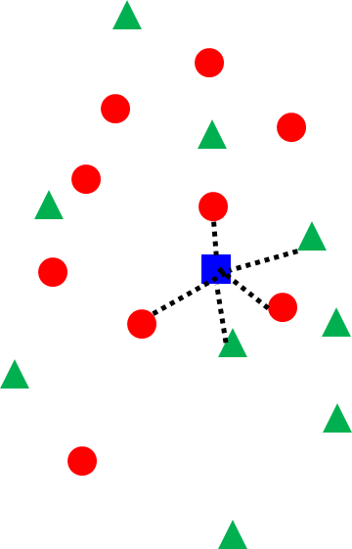
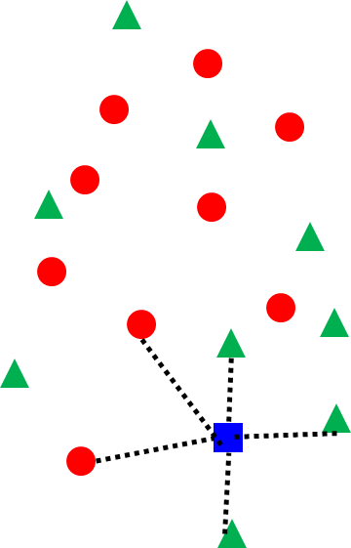
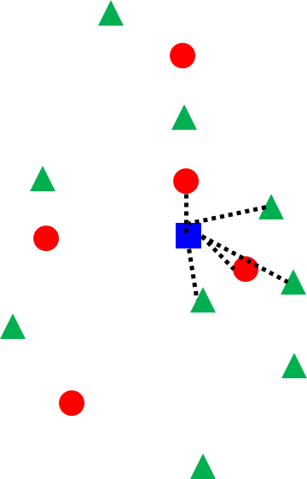
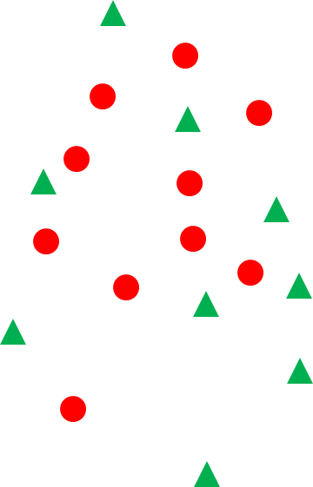
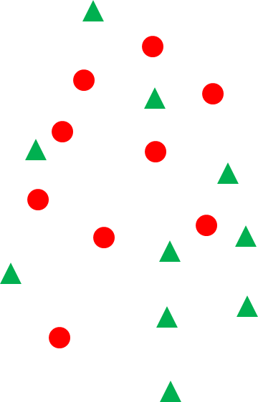
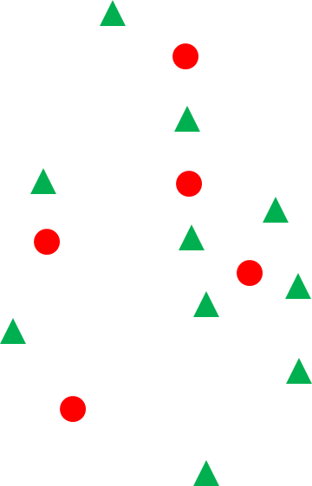
Now, divide data into train, validation and test sets
We can use numpy.split for this purpose
np.split(data, [end of first portion, end of second portion, …])
train, valid, test = np.split(df.sample(frac=1, replace=False), [int(0.6*len(df)), int(0.8*len(df))])
Scale, and oversample or undersample training data!

Slide 27
K nearest neighbors (KNN)

Slide 28
Basic Idea: The fundamental idea behind KNN is to predict the class of a data point by looking at the 'k' closest data points (neighbors) to that point. It assumes that similar data points are close to each other in the feature space.
Distance Metric: KNN relies on a distance metric to measure the similarity between data points. Common distance metrics include Euclidean distance, Manhattan distance, Minkowski distance, etc. Euclidean distance is the most commonly used metric in KNN.

Slide 29
Training: KNN doesn't explicitly train a model during the training phase. Instead, it memorizes the entire training dataset. This makes the training phase fast but the prediction phase potentially slow, especially for large datasets.
Choosing 'k': The choice of 'k' is crucial in KNN. A small 'k' value can make the model sensitive to noise, while a large 'k' value can lead to the inclusion of irrelevant data points. Typically, 'k' is chosen using cross-validation techniques to find the value that yields the best performance on unseen data.
Weighted KNN: In some cases, you may want to assign weights to the neighbors based on their distance to the query point. Closer neighbors are given higher weights, while farther ones are given lower weights. This helps in improving the accuracy of the prediction.
Regression with KNN: KNN can also be used for regression tasks. In regression, instead of predicting a class label, it predicts a continuous value by averaging the target values of the 'k' nearest neighbors.

Slide 30
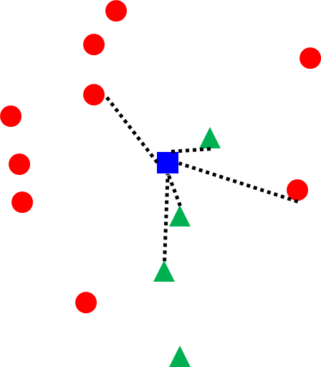
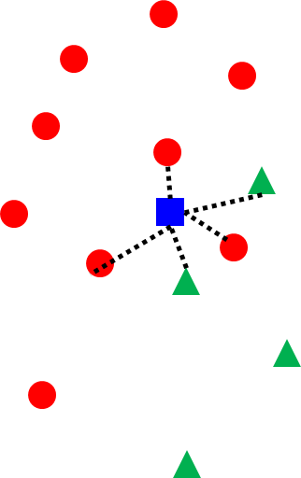
Pros:
Simple to implement.
No assumption about the underlying data distribution.
Can handle multi-class classification problems.
It performs well with a small number of input variables.
Cons:
Computationally expensive during the prediction phase, especially with large datasets.
Sensitive to irrelevant features and the choice of distance metric.
Requires a significant amount of memory to store the entire training dataset.
Not suitable for high-dimensional data due to the curse of dimensionality.
y
y
x
z

